Slide 1
SQL 2014 In-Memory OLTP
Amanda Ford
Adebimpe Alabi
Microsoft

Slide 3
Agenda
In Memory OLTP Overview
Memory Optimized Tables
Native Compiled Stored Procedures
Migration to In-Memory Objects and things to consider…

Slide 4
SQL 2014 In-Memory OLTP
In Memory OLTP Overview

Slide 5
In-Memory OLTP Summary
Customer Benefits
High performance data operations
Efficient business-logic processing
Frictionless scale-up
Hybrid engine and integrated experience
Architectural Pillars
Main-Memory Optimized
T-SQL Compiled to Machine Code
High Concurrency
SQL Server Integration
Optimized for in-memory data
Indexes (hash and range) exist only in memory
No buffer pool, B-trees
Stream-based storage
T-SQL compiled to machine code via C code generator and VC
Invoking a procedure is just a DLL entry-point
Aggressive optimizations at compile-time
Multi-version optimistic concurrency control with full ACID support
Core engine uses lock-free algorithms
No lock manager, latches or spinlocks
Same manageability, administration & development experience
Integrated queries & transactions
Integrated HA and backup/restore
Drivers
Hardware trends
Business
Steadily declining memory price, Non-volatile RAM
Stalling CPU clock rate
Many-core processors
TCO

Slide 6
Myths
In-Memory OLTP is like DBCC PINTABLE
In-Memory databases are new separate products
You can use In-Memory OLTP in an existing SQL Server app with NO changes whatsoever
Since tables are in memory, the data is not durable or highly available; data is lost after a server crash

Slide 7
In Memory OLTP Architecture
Client App
TDS (Client Server Communications) Handler and Session Management
Key
SQL Server.exe
Parser, Catalog, Optimizer
T-SQL Query Execution
Existing SQL Component
Natively Compiled SPs and Schema
Native Compiler
Non-durable table
In-mem OLTP Component
Memory Optimized Tables & Indexes
Query Interop
Buffer Pool for Tables & Indexes
T1
T2
T3
Generated .dll
Tables
Indexes
Memory Optimized Data Filegroup
Transaction Log
Data Filegroup
T1
T2
T3
T1
T2
T3

Slide 8
Performance Gains
Client App
TDS (Client Server communication) Handler and Session Management
SQL Server.exe
Key
No improvements in: communication stack, parameter passing, result set generation
Parser, Catalog, Optimizer
Existing SQL Component
Native Compiler
T-SQL Query Execution
In-mem OLTP Component
Natively Compiled SPs and Schema
10-30x more efficient
Generated .dll
Removes lock and latch contention
Query Interop
Buffer Pool for Tables & Indexes
Engine for Memory_optimized Tables & Indexes
Reduced log contention
Memory-optimized Table Filegroup
Transaction Log
Data Filegroup

Slide 9
SQL 2014 In-Memory OLTP
In Memory Storage

Slide 10
Create Filegroup
FileGroup Container
CREATE DATABASE [Hekaton]
ON PRIMARY
(NAME = N'Hekaton_data', FILENAME = N'C:\Data\Data\Hekaton_data.mdf'),
FILEGROUP [Hekaton_InMemory] CONTAINS MEMORY_OPTIMIZED_DATA
(NAME = N'Hekaton_mem', FILENAME = N'C:\Data\Mem\Hekaton_Lun1.mdf')
LOG ON
(NAME = N'Hekaton_log', FILENAME = N'C:\Data\Log\Hekaton_log.ldf')
ALTER DATABASE [Hekaton]
ADD FILE (NAME = N'Hekaton_mem', FILENAME = N'C:\Data\Mem\Hekaton_Lun2.mdf')
TO FILEGROUP [Hekaton_InMemory]
Notes:
CONTAINS MEMORY_OPTIMIZED_DATA
-Specifies that the filegroup stores memory optimized data in the file system.
-Only one MEMORY_OPTIMIZED_DATA filegroup is allowed per database.
-For creating memory optimized tables, the filegroup cannot be empty. There must be at least one file. The filegroup_name refers to a path. The path up to the last folder must exist, and the last folder must not exist.
'memory_optimized_data_path'
For a memory-optimized filegroup, FILENAME refers to a path where memory-optimized data will be stored. The path up to the last folder must exist, and the last folder must not exist. For example, if you specify the path C:\MyFiles\MyData, C:\MyFiles must exist before you run ALTER DATABASE, but the MyData folder must not exist.
The filegroup and file (<filespec>) must be created in the same statement.
The SIZE, MAXSIZE, and FILEGROWTH properties do not apply to a memory-optimized filegroup.

Slide 11
Create Memory Optimized Table
Hash Index
CREATE TABLE [Customer] (
[CustomerID] INT NOT NULL
PRIMARY KEY NONCLUSTERED HASH WITH (BUCKET_COUNT = 1000000),
[AddressID] INT NOT NULL INDEX [IxName] HASH WITH (BUCKET_COUNT = 1000000),
[LName] NVARCHAR(250) COLLATE Latin1_General_100_BIN2 NOT NULL
INDEX [IXLName] NONCLUSTERED (LName)
)
WITH (MEMORY_OPTIMIZED = ON, DURABILITY = SCHEMA_AND_DATA);
Collation BIN2
Range Index
This table is memory optimized
This table is durable
Notes:
This is required once the table is created, you are not allowed to create or drop index as the table is compiled into a DLL and so any changes to the table will require a drop and a recreation of the table.
There is no Clustered index for Memory optimized tables as data access patterns are totally different. We will cover data access patterns in a later module. WE USE A HASH INDEX THAT IS NEW IS SQL 2014 FOR IN MEMORY DATA IN 2014
Nullable columns in index keys are not supported with memory optimized tables.
Character columns that require indexes have to use the BIN_2 collation. - to work with the natively compiled sp’s..
Bucket count should be set to between one and two times the maximum expected number of distinct values in the index key. We will discuss this at a later point.
MEMORY_OPTIMIZED
Indicates whether the table is memory optimized. Memory-optimized tables are in memory user tables, the schema of which is persisted on disk similar to other user tables. Memory-optimized tables can be accessed from natively compiled stored procedures.
DURABILITY
The value of SCHEMA_AND_DATA indicates that the table is a durable, memory-optimized table. DURABILITY=SCHEMA_AND_DATA can be used with MEMORY_OPTIMIZED=OFF. SCHEMA_AND_DATA is the default value for memory-optimized tables. The value of SCHEMA_ONLY indicates that the table is non-durable. The table schema is persisted but any data updates are not persisted upon a restart of the database with Memory-optimized objects. DURABILITY=SCHEMA_ONLY is not allowed with MEMORY_OPTIMIZED=OFF.
Most customers ask how big can an in memory table be?
Approach with SQL is not to move the whole DB – use the workload analyser and after a day or a few hours, then it will come back and say this and that table..

Slide 12
In-Memory Row Format
Row Header | Payload (Actual column data)
Begin Ts | End Ts | StmtID | IdsLinkCount | Index1 ptr | Index2 ptr
8 bytes
8 bytes
4 bytes
2 bytes + 2 for padding
8 bytes * Number of Indexes
Begin/End timestamp determines row’s version validity and visibility
No concept of data pages, only rows exist
Row size limited to 8060 bytes (@table create time) to allow data to be moved to disk-based tables
Not every SQL table schema is supported (Ex: LOB and SqlVariant)

Slide 13
Memory Optimized Table Limitations
Optimized for high-throughput OLTP
No XML and no CLR data types
Optimized for in-memory
Rows are at most 8060 bytes – no off row data
No Large Object (LOB) types like varchar(max)
Scoping limitations
No FOREIGN KEY and no CHECK constraints
No schema changes (ALTER TABLE) – need to drop/recreate table
No add/remove index – need to drop/recreate table
No Computed Columns
No Cross-Database Queries

Slide 14
Hash Indexes
Hash index with (bucket_count=8):
Hash function f:
Maps values to buckets
Built into the system
Hash index mapping:
f(Claire)
0
Array of
8-byte
Memory
pointers
1
f(John)
2
f(Mike)
Hash
Collisions
3
4
f(Susan)
5
f(David)
6
7

Slide 15
Hash Index Traversal
Hash index
mapping:
Chain Ptrs
Name
0
1
John
2
3
4
5
Mike
6
7

Slide 16
SQL 2014 In-Memory OLTP
Demo: The bucket count

Slide 17
Memory Optimized Table Insert
Timestamps
Chain ptrs
Name
City
Hash index on Name
Hash index on City
50, ∞
Jane
Prague
f(John)
f(Prague)
100, ∞
John
Prague
90, ∞
Susan
Bogota
T100: INSERT (John, Prague)

Slide 18
Memory Optimized Table Delete
Timestamps
Chain ptrs
Name
City
Hash index on Name
Hash index on City
50, ∞
Jane
Prague
100, ∞
John
Prague
90, 150
90, ∞
Susan
Bogota
T150: DELETE (Susan, Bogota)

Slide 19
Memory Optimized Table Update
Timestamps
Chain ptrs
Name
City
Hash index on Name
Hash index on City
50, ∞
Jane
Prague
f(John)
100, ∞
100, 200
John
Prague
f(Beijing)
200, ∞
John
Beijing
90, 150
Susan
Bogota
T200: UPDATE (John, Prague) to (John, Beijing)

Slide 20
Garbage Collection
Timestamps
Chain ptrs
Name
City
Hash index on Name
Hash index on City
f(Jane)
50, ∞
Jane
Prague
f(John)
f(Prague)
100, 200
John
Prague
f(Beijing)
200, ∞
John
Beijing
90, 150
Susan
Bogota
T250: Garbage collection
Notes:
In Time your DELETE and UPDATE operations will generate row versions that will eventually become stale, which means they will no longer be visible to any transaction and these stale versions will slow down scans of index structures and create unused memory that needs to be reclaimed. The Garbage collection process is designed to clean up these stale rows. To determine which rows can be safely deleted, the system keeps track of the timestamp of the oldest active transaction running in the system, and uses this value to determine which rows are still potentially needed. Any rows that are not valid as of this point in time (that is, their end-timestamp is earlier than this time) are considered stale. Stale rows can be removed and their memory can be released back to the system.
It is the responsibility of the Garbage Collector to reclaim the memory taken by stale row versions. Memory from the stale rows is reclaimed when a client transaction commits. Following the transaction commit and before releasing the CPU, a block of stale rows in the queue are released, freeing up that memory for re-use.
As you use a memory optimized table in production, it is recommended that you monitor its memory usage so you can make adjustments and avoid OOM (Out of Memory) situations. We will cover Garbage collection internals in later lessons.

Slide 21
Non Clustered (Range) Index
No latch for page updates
No in-place updates on index pages
Page size- up to 8K. Sized to the row
Sibling pages linked one direction
No covering columns (only the key is stored)
Page Mapping Table
0
PAGE
Physical
1
PAGE
Root
2
10
20
28
PageID-0
3
PageID-3
PageID-5
4
8
10
11
15
18
21
24
27
Non-leaf pages
PageID-6
Logical
PageID-15
1
2
4
5
6
7
25
26
27
Leaf pages
14
200, ∞
1
50, 300
2
Data rows
15
Key
Key
100, 200
1

Slide 22
In-Memory OLTP Structures summary
Rows
Row structure is optimized for memory access
There are no Pages
Rows are versioned and there are no in-place updates
Fully durable by default (but they don’t have to be)
Indexes
There is no clustered index, only non-clustered indexes
Indexes point to rows, access to rows is via an index
Indexes do not exist on disk, only in memory, recreated during recovery
Hash indexes for point lookups
Range indexes for ordered scans and Range Scans

Slide 23

Memory Issues?
Available Memory
Memory Optimized Tables
Memory Optimized Tables
Memory Optimized Tables
Memory Optimized Tables
Max Server Memory
Memory Internal Structures
Memory Internal Structures
Memory Internal Structures
Buffer Pool
Buffer Pool
Memory Internal Structures
Buffer Pool
Buffer Pool

Slide 24
Memory Considerations
Scenario
Symptom
Diagnosis
Solution
Inserting more rows than rows that can fit in memory
Transactions start failing
Read error log
Identify via DMVs,
SSMS whether In
Memory OTLP is using most memory
Free up
memory
Add memory
Identify and stop long running transactions
Recovering database that does not fit in memory
Database does not come online
Memory pressure due to In-Memory OLTP on other workloads
Operations in other workloads start failing

Slide 25
SQL 2014 In-Memory OLTP
On Disk Storage

Slide 26
Durability
Memory optimized tables can be durable or non-durable
Non-durable tables are ideal for transient data
Default is durable
Single memory optimized filegroup
Sequential IO pattern (no random IO)
Filegroup can have multiple containers to aid in parallel recovery
Recovery depends on IO speed – recommend SSD or Fast SAS drives
CREATE TABLE [dbo].[SalesOrder_MemOpt] (
[Order_ID] INT NOT NULL,
[Order_Date] DATETIME NOT NULL,
[Amount] FLOAT NOT NULL,
CONSTRAINT PK_SalesOrderID PRIMARY KEY NONCLUSTERED HASH (Order_ID)
)
WITH (MEMORY_OPTIMIZED = ON, DURABILITY = SCHEMA_AND_DATA);

Slide 27
Storage
Filestream container is the underlying storage mechanism
Data files
~128MB in size, write 256KB chunks at a time ( 16MB if Server has < 16GB RAM)
Stores only the inserted rows (i.e. table content)
Chronologically organized streams of row versions
Delta files
File size is not constant, write 4KB chunks at a time
Stores IDs of deleted rows

Slide 28
Data and Delta Files
0
100
Transaction Timestamp Range
Data File
TS (ins)
RowId
TableId
Row pay load
TS (ins)
RowId
TableId
Row pay load
TS (ins)
RowId
TableId
Row pay load
Data file contains rows inserted
within a given transaction range
Checkpoint File Pair
Delta File
TS (ins)
RowId
TS (del)
TS (ins)
RowId
TS (del)
TS (ins)
RowId
TS (del)
Delta file contains deleted rows
within a given transaction range

Slide 29
Merge Operation
Merge Operation
Files as of Time 500
Files as of Time 600
Memory-optimized data Filegroup
Memory-optimized data Filegroup
Range 100-200
Range 200-300
Range 300-400
Range 400-500
Range 100-200
Range 200-300
Range 200-400
Range 400-500
Range 500-600
Range 200-299
Range 300-399
Range 300-400
Merge
200-400
Data file with rows generated in timestamp range
IDs of Deleted Rows (height indicates % deleted)
Files Under Merge
Deleted Files

Slide 30
Demonstration: Data and Delta State Transitions

Slide 31
SQL 2014 In-Memory OLTP
Native Compilation

Slide 32
Natively Compiled Procedures
CREATE PROCEDURE [dbo].[InsertOrder](@id INT, @date DATETIME)
WITH
NATIVE_COMPILATION,
SCHEMABINDING,
EXECUTE AS OWNER
AS
BEGIN ATOMIC
WITH
(TRANSACTION ISOLATION LEVEL = SNAPSHOT,
LANGUAGE = N'us_english')
-- Insert T-SQL here…
END
This proc is natively compiled
Native procs must be schema-bound
Execution context is required
Atomic blocks
Create a transaction if there is none
Otherwise, create a savepoint
Session settings are fixed at create time

Slide 33
Data Access to Memory Optimized Tables
Interpreted T-SQL Access
Access both memory- and disk-based tables
Less performant
Virtually full T-SQL surface
When to use
Ad hoc queries
Reporting-style queries
Speeding up app migration
Natively Compiled Procs
Access only memory optimized tables
Maximum performance
Limited T-SQL surface area
When to use
OLTP-style operations
Optimize performance critical business logic
More the logic embedded, better the performance improvement

Slide 34
Native Compilation Process
Compile T-SQL statements and table data access logic into machine code
DLL
sqlservr.exe
Create table/proc/variable
SQL Engine
In-Memory Compiler
VC compiler/linker
.c file
Parser/Algebrizer/
Metadata/Query Optimizer
Optimized query tree / metadata
code generation

Slide 35
Natively Compiled Procedures Restrictions
Serial execution plan
In-Memory tables restriction → No Parallel Plan!
Not all operators/TSQLs are supported
Only Nested Loop join, no TSQL MERGE or EXISTS, cursors, MARS, nested queries
Transaction isolation level
SNAPSHOT, REPEATABLEREAD, and SERIALIZABLE
READ COMMITTED and READ UNCOMMITED is not supported
Collation
Comparison, sorting, and other operations on character strings require BIN2 collations

Slide 36
Natively Compiled Procedures Restrictions
Cannot access disk-based tables
No TEMPDB! Use In-Memory Table variables
No parameter sniffing
Optimize for UNKNOWN
No automatic recompile on statistics changes
Need to stop & start SQL or drop & create procedure

Slide 37
SQL 2014 In-Memory OLTP
Migration

Slide 38
Iterative Methodology
Establish perf baseline
Setup data collection (MDW)
Configure data collection
Run workload
Run AMR reports
Migrate tables
Migrate stored procedures
Collect perf data
Compare to baseline

Slide 39
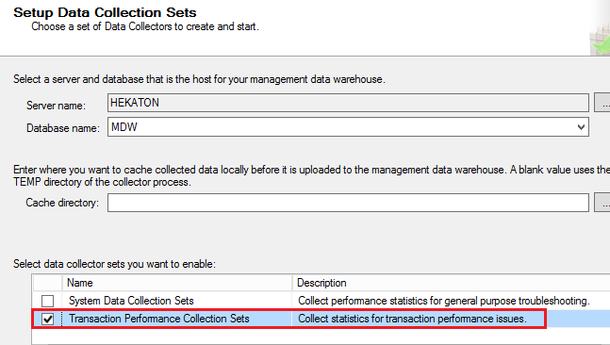
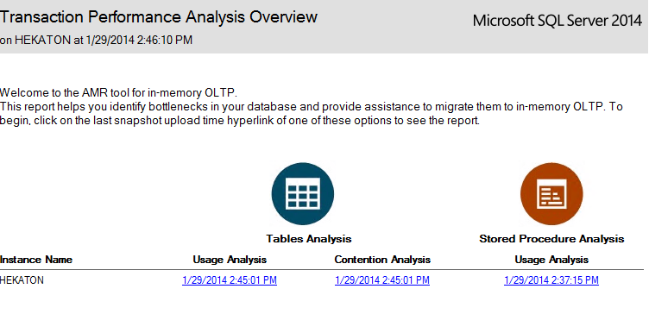
AMR Toolset Data Collectors
Management data warehouse “New collectors” assist in analyzing migration candidates
Can be run remotely

Slide 40
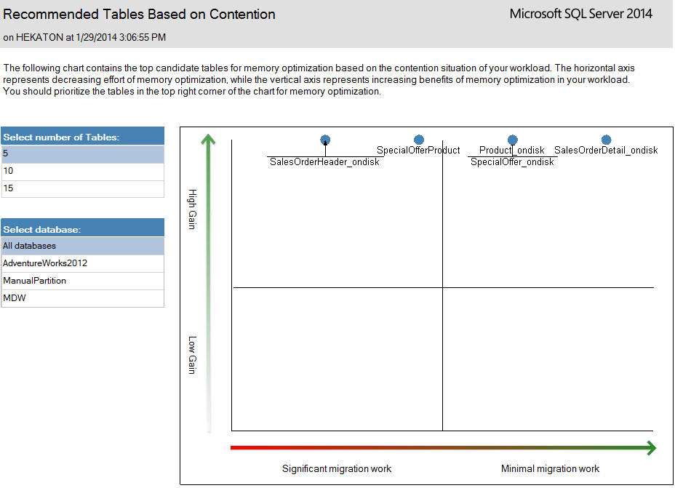
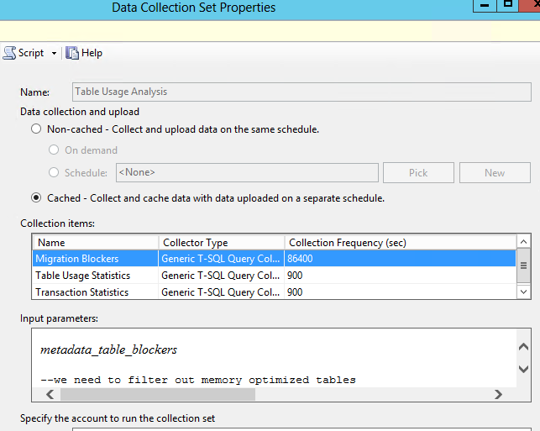
Table Usage Analysis

Slide 41
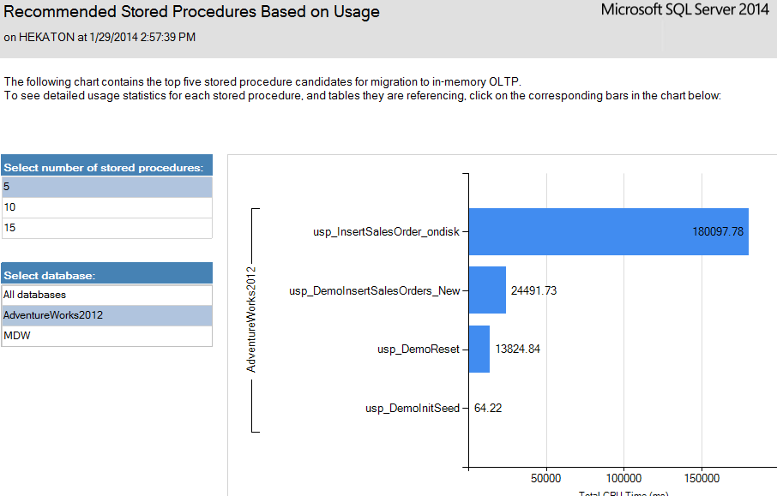
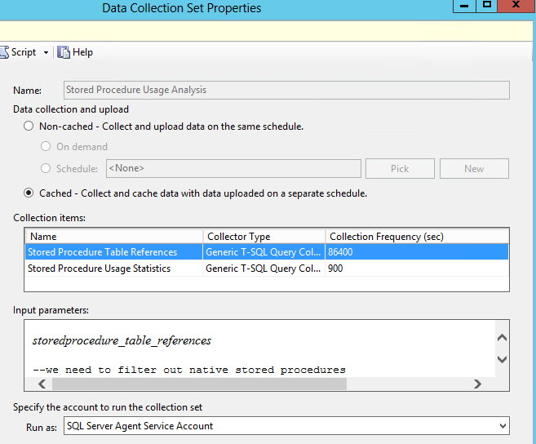
Stored Procedure Usage Analysis
Primarily looks at sys.dm_exec_procedure_stats
Drill down to referencing objects

Slide 42
Q&A

Slide 43


